Slide 1
Input Management

Slide 2
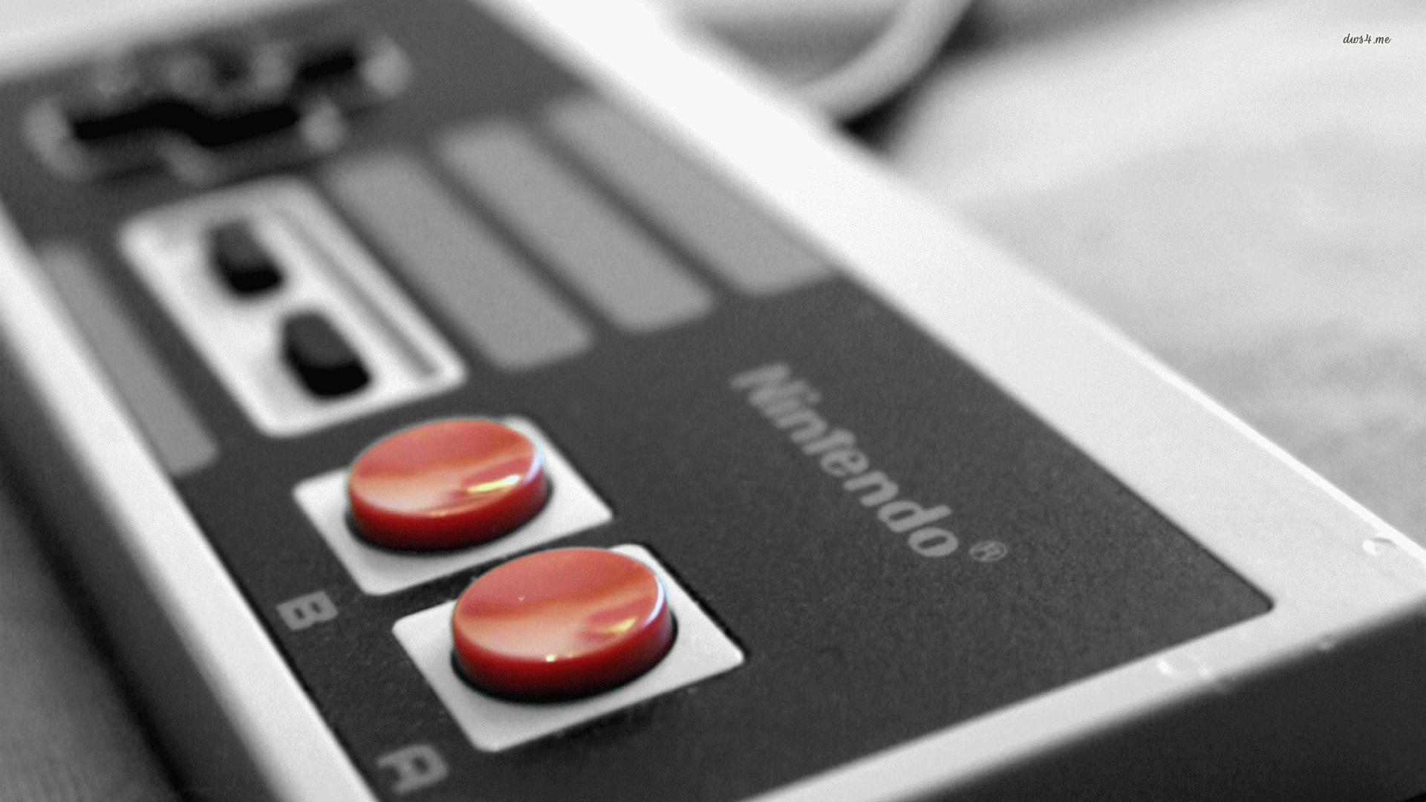
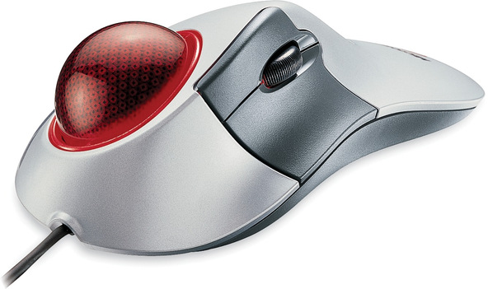
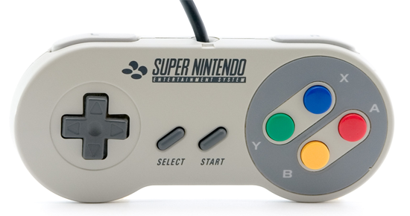
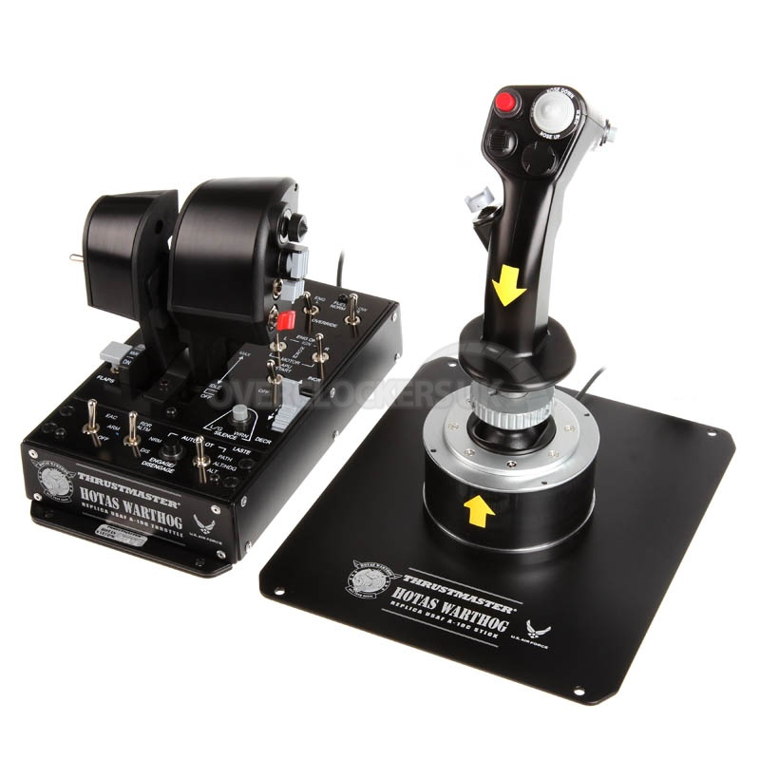
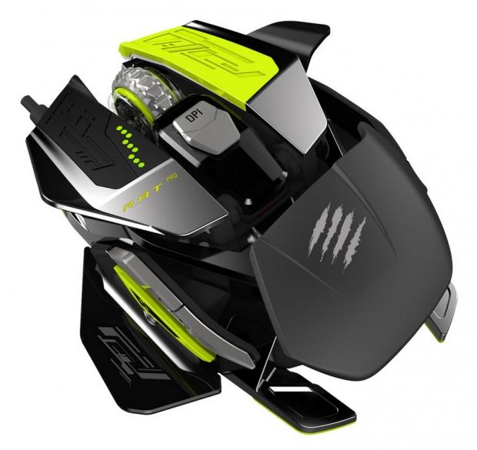
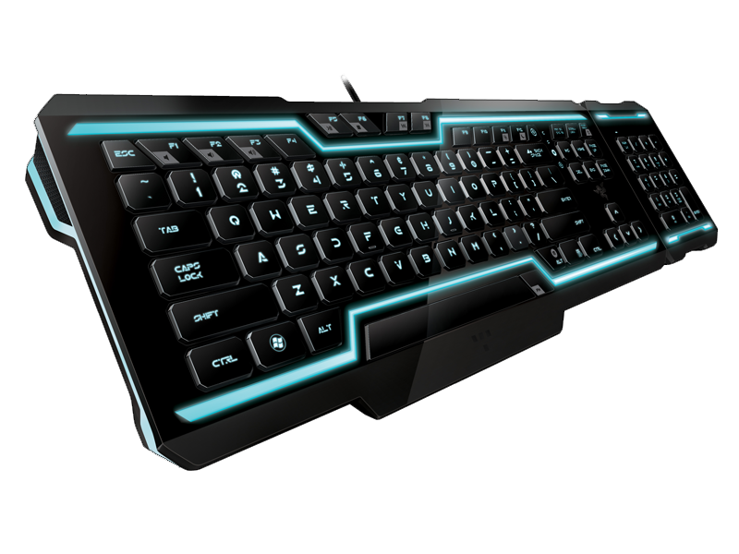
Notes:
Human Interface Devices (or HIDs) come in all sorts of shapes and sizes – Some that are “standard” such as joysticks, joypads, keyboards, mice and, track balls. Some that are a bit more esoteric: the wiimote, plastic guitars, fishing rods and dance pads.
We’ll talk about how game engines can handle these devices, how they read and process the data and how we can utilize the inputs. Input devices can sometimes also serve as output devices, so we’ll talk about that a little bit too.
Our focus will be on joysticks, joypads and keyboards and mice – but a lot of the same theory works for other devices.

Slide 3

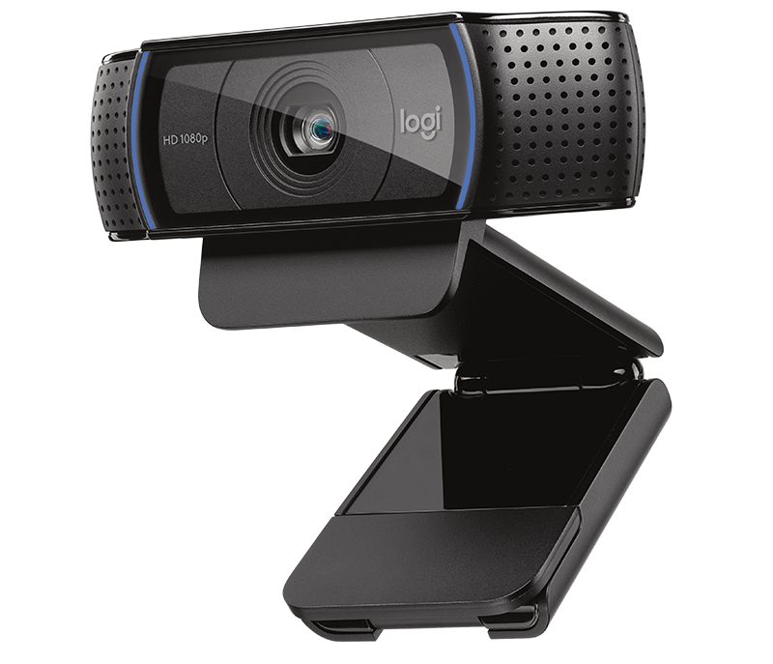
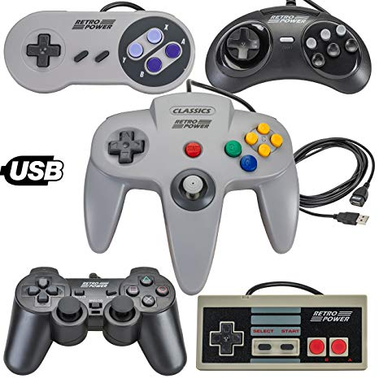
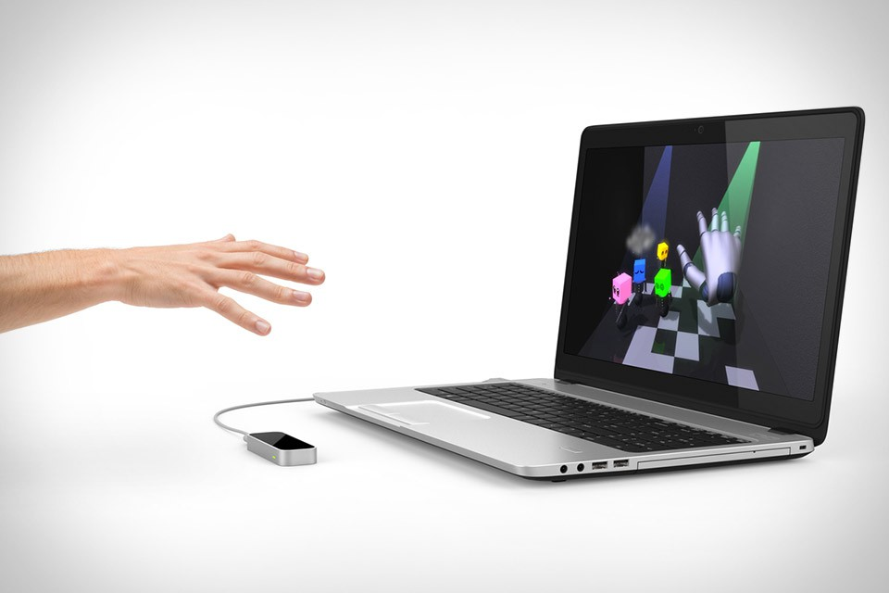

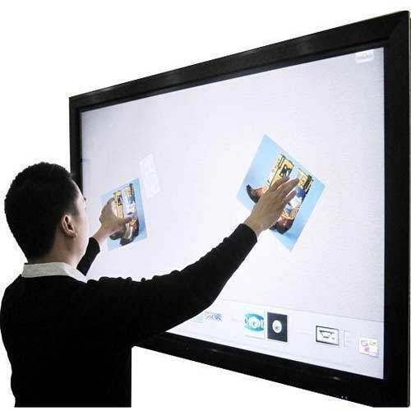
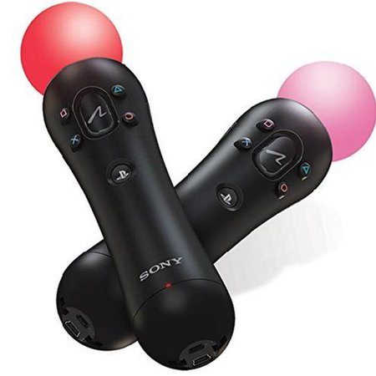
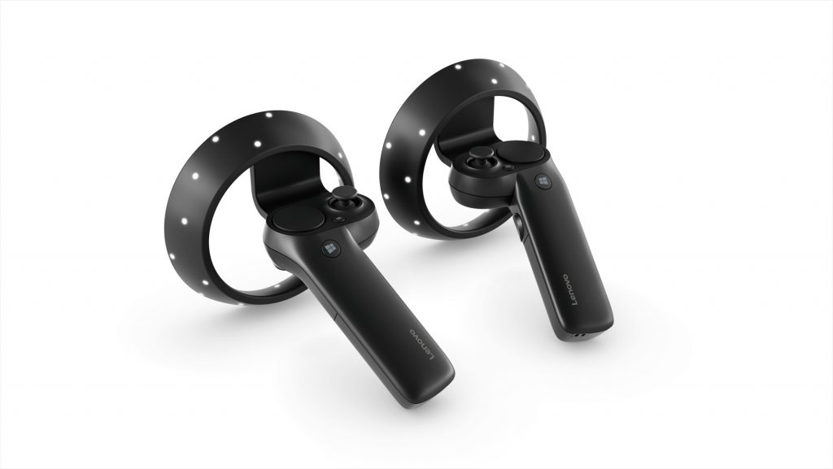
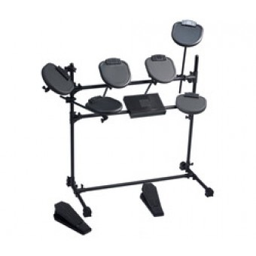

Slide 4
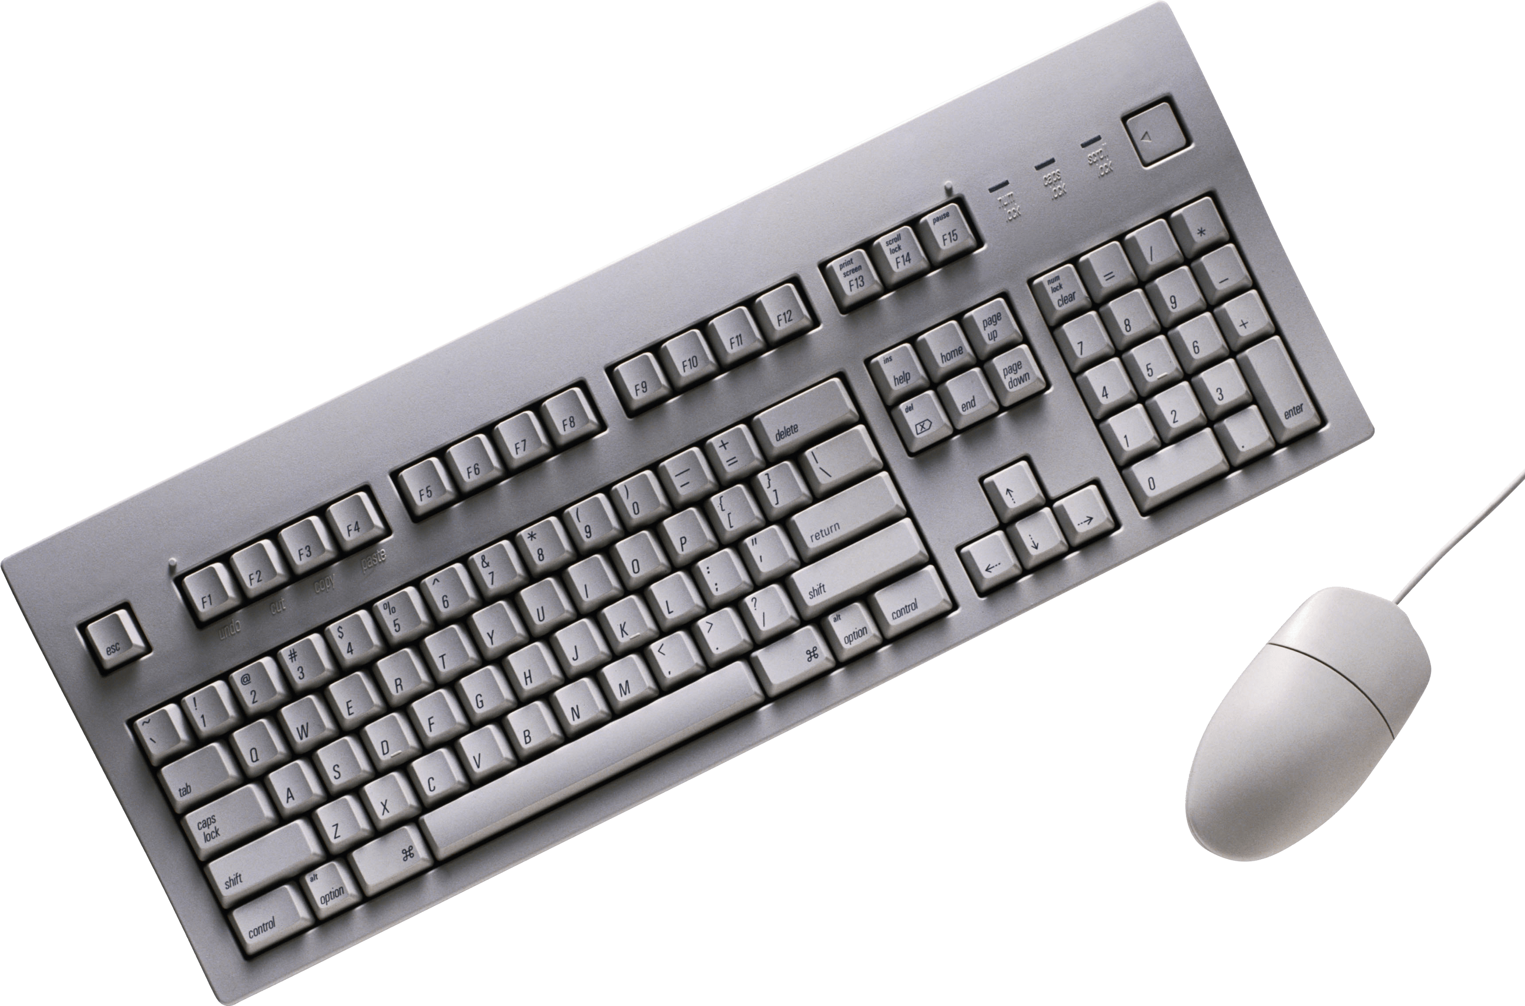
Notes:
But for now we’re just interested in these

Slide 5

Polling
Notes:
There are a number of ways to actually interface with a HID – which we use depends a little on the type of HID.
Polling: some gamepads and older style joysticks are read by querying the device for its current state – we do this every frame (generally).
Typically, this happens by either reading hardware registers directly, reading the memory mapped I/O port or via higher level software interface (which does those lower level elements for us)
The Xinput API from Microsoft is just such a higher level interface for working with Xbox pads on the console and Windows devices – it works via the polling method. Every frame we call XInputGetState(), which communicates with the hardware, reads the relevant data and packages it up for us into a XINPUT_STATE struct. This struct gives us access to the current state of all the controls (buttons, thumb sticks and triggers).
NB: in C++ a struct is the same as a class except all its members are public by default.

Slide 6
Polling
Interrupts
Notes:
Some devices only send information to the game engine when their state changes in some way – the mouse tends to just sit on the mouse mat, so there’s no need to send a continuous stream of data to the system. Instead, it only transmits information when it moves or when a button is pressed or released.
These sorts of devices usually communicate with the computer using something called hardware interrupts, which is an electronic signal generated by the device. These signals cause the CPU to stall its current activity (suspending the currently running application) and run an interrupt service routine (ISR).
Interrupts are used for all sorts of things, in the case of a HID, the ISR code will probably read the state of the device store it off for later processing and then relinquish CPU control back to the main application.
This lets the game engine pick up the data at a later point when it’s convenient.
It’s very, very rare for an interrupt to cause a visible hitch in our games – CPUs are so fast that the skip in processing is impossible to detect, but it used to be that interrupts could cause a visible pause in gameplay!

Slide 7
Polling
Interrupts
Wireless
Notes:
If we’re working with wireless devices (such as the wii remote or a wireless game pad like the 360) then we can’t access their state via registers or memory mapped I/O ports.
Instead we need to use the relevant wireless protocol (Bluetooth for the wiimote). The software can then request the device send its current input data (button states etc) or it can send output data (rumble or an audio stream for the wiimote).
We want to make this process as invisible as possible to the game programmer, ideally the entire process should be encapsulated in such a way that it is used in exactly the same way as wired controllers – this might require that we do the device interaction on a separate thread.
It’s up to you as to which approaches you handle in your game engine, some of which may depend on if you decide to try and implement your own input management system or research an existing library that will do that for you.

Slide 8
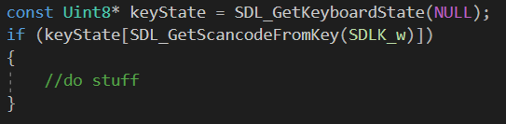
Getting key presses from SDL
This code gets the current state of the keyboard.
Using that state it checks to see if the scan code of the w key is true (i.e. pressed).
If it is, we do stuff!
The NULL parameter is used to get the number of keys pressed.

Slide 9
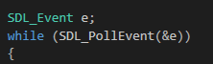
Polling
You will have to ask SDL, regularly, what the current state of the keyboard is
This is called Polling
And its inefficient
Event queues are better
Look in to them

Slide 10
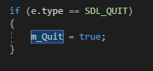
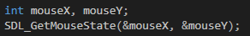
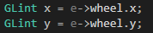
Other events
Could be used to exit our main loop and close our program
We can look for more than just key presses too.
See
https://wiki.libsdl.org/SDL_Event
Could be used to move a camera based on mouse movement or zoom based on scrolling.
Gets the current mouse state
Gets the mouse scroll wheel state.

Slide 12
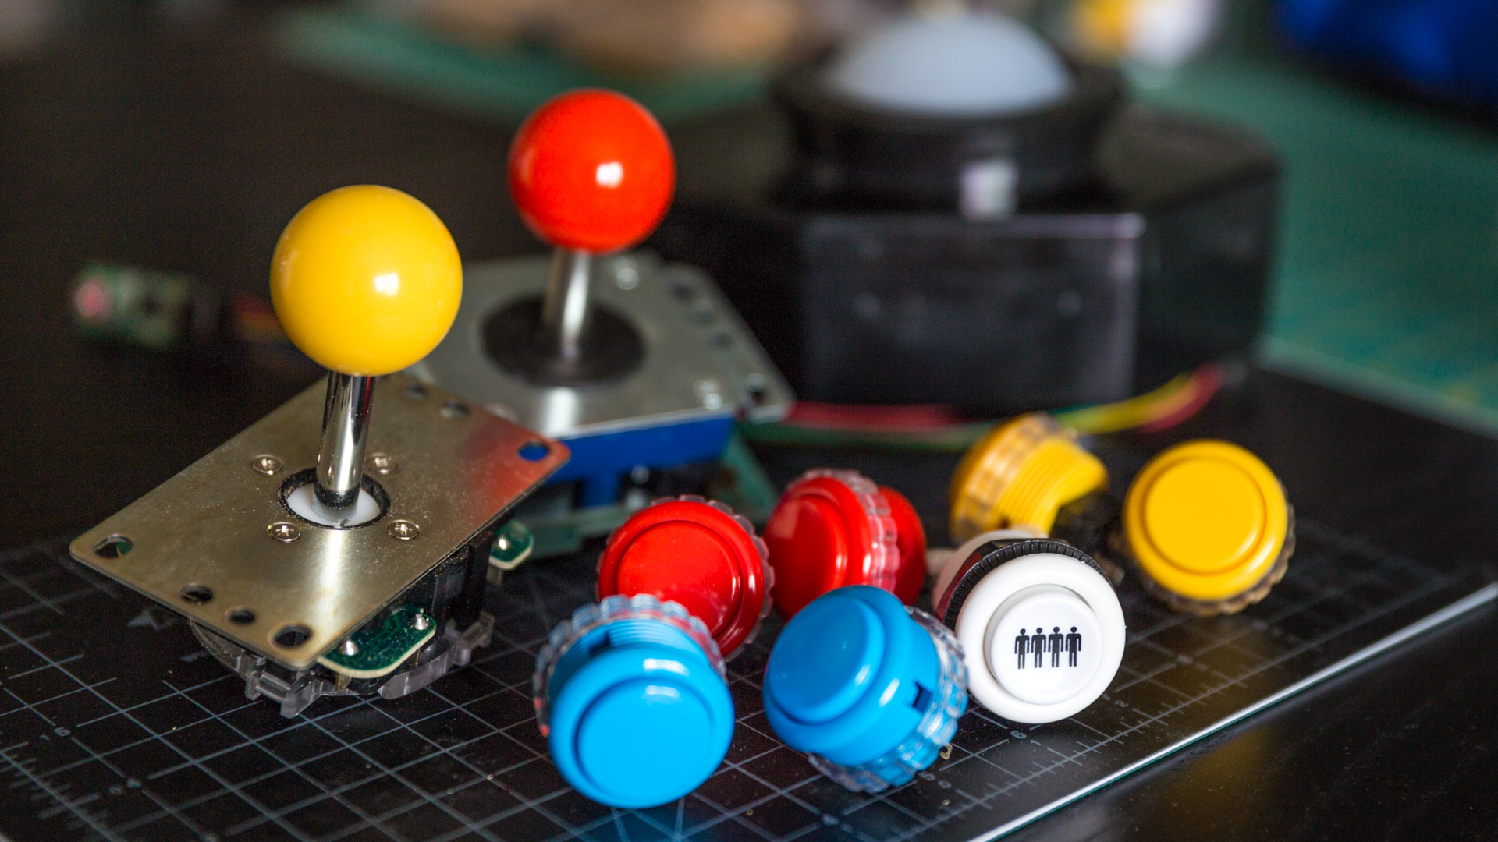
#define XINPUT_GAMEPAD_RIGHT_THUMB 0x0080 // bit 7
#define XINPUT_GAMEPAD_LEFT_SHOULDER 0x0100 // bit 8
#define XINPUT_GAMEPAD_RIGHT_SHOULDER 0x0200 // bit 9
#define XINPUT_GAMEPAD_A 0x1000 // bit 12
#define XINPUT_GAMEPAD_B 0x2000 // bit 13
#define XINPUT_GAMEPAD_X 0x4000 // bit 14
#define XINPUT_GAMEPAD_Y 0x8000 // bit 15
bool IsButtonADown(const XINPUT_GAMEPAD& pad)
{
// Mask off all bits but bit 12 (the A button).
return ((pad.wButtons & XINPUT_GAMEPAD_A) != 0);
}
Notes:
Although controllers vary quite a lot in layout and form factor, they tend to share a common set of actual inputs.
The front facing buttons on most modern gamepads are “digital buttons” – they have two states, pressed or not pressed (we sometimes refer to them as being “up” or “down”)
The state of a digital button is represented with a single bit, it’s common for 0 to represent “up” (not pressed) and for 1 to represent “down” (pressed) – but this depends quite a bit on the design of the device and the driver developers as to which way round this will actually be. We can always massage the values into a generic setup for our engine.
Because they’re stored as bits, we can pack a lot of button data into a single unsigned int – the Xinput library mentioned earlier gives us the state of all the digital buttons on a 360 pad in the XINPUT_GAMEPAD struct as a single variable “wButtons” that has a type of word (words are unsigned values that typically take up 16 bits (2 bytes)).
Each of the physical buttons then have a bit assigned to them: A is the 12th bit, B the 13th, X the 14th and Y the 15th.
We can check an individual buttons value from the wButton word with a bitmask using the bitwise operator (&):

Slide 13
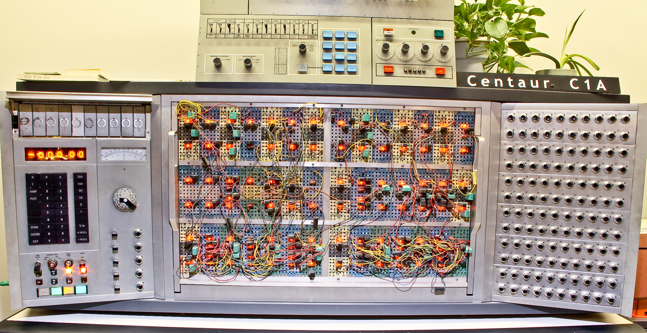
typedef struct _XINPUT_GAMEPAD
{
WORD wButtons;
// 8-bit unsigned
BYTE bLeftTrigger;
BYTE bRightTrigger;
// 16-bit signed
SHORT sThumbLX;
SHORT sThumbLY;
SHORT sThumbRX;
SHORT sThumbRY;
} XINPUT_GAMEPAD;
Notes:
Gamepads and joysticks also have analogue inputs – which can take on a range of values (rather than just 0 or 1)
These kinds of inputs are used to represent the two dimensional position of a joystick (which is in fact two analogue inputs, x and y) or the degree to which a trigger has been pressed. Some times, the front buttons of a gamepad are also analogue, but that’s rare – the dualshock 2 had analogue front buttons rather than digital, allowing an engine to read how far you had pressed one of them to a much more exact degree.
Strictly, by the time the signal has reach the engine, they are no long analogue, having been digitized and converted into an integer value – so the input value might range from -32,768 to 32,768 if represented by a 16 bit signed integer, sometimes they’re converted into a floating value which ranges between -1 and 1 instead.
Our faithful friend XINPUT_GAMEPAD represents the deflections of the thumbsticks as 16-bit signed integers (sThumbLX and sThumbLY for left, sThumbRX and sThumbRY for the right) – while triggers are represented as 8 bit unsigned integers, giving a range between 0 and 255 (fully pressed). Different game machines will have different analogue representations of their input states!
Generally, these axes values are represented as absolute values – so we have a clear understanding of where the zero position lies. But some devices will report their position in terms of a relative. In which case knowing the zero location is problematic, as a zero reading from the device just means it has not moved, while a non-zero value gives us the difference (or delta) from the last time it was read. Most mice type devices work like this (mice, trackballs etc)

Slide 14

Notes:
Some input devices also allow us to use them as output devices too:
The most common feature is rumble (or vibration) – rumble is usually generated by one or two motors, which the game engine can control independently to try and simulate basic force feedback (so a car going off road, the rumble when a tank goes past in an FPS game etc).
A more precise form of this is offered through force feedback, which uses an actuator in the device to provide resistance to the player – this is pretty common in steering wheel devices for arcade games, with the wheel resisting the players attempts to turn it. The game engine gets slightly finer control over the force feedback motor.
Some HIDs can be used to playback audio - the Wiimote has a speaker built in, while all recent xbox and playstation pads have headphone jacks for a headset which can be used for voice chat or standard audio. Our interface to the device will allow us to send a correctly formatted audio stream straight through to these audio outputs, though we have to be aware when such things are optional (such as the headsets on xbox or playstation pads).
There’s a broad range of other I/O on input devices – lots of them have LEDs that can be controlled via software (the dualshock 4 has the light bar, wiimotes have 4 LEDs on them) and specialised devices like steering wheels, guitars and drum kits all have their own unique elements that we might have to account for.

Slide 15
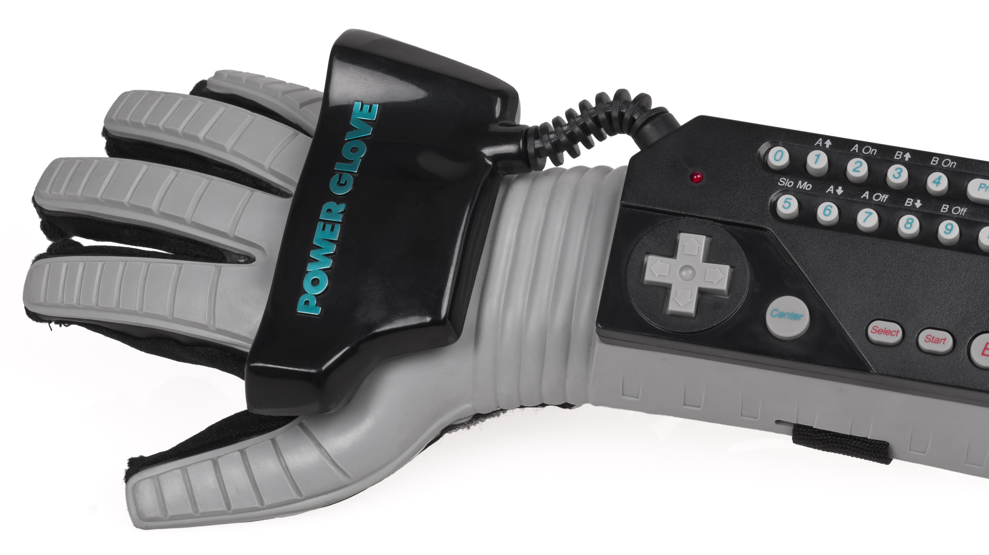
Dead zones
Event detection
Button sequences
Chords
Gesture detection
Multiple HID management
Controller input remapping
Notes:
Our HID management system should be able to offer at least some or all of the following:
We’ll talk about some of these in a bit more detail – but for really in depth coverage, take a look at the library copies of game engine architecture!

Slide 16


Slide 17
Input values could in in any range, 0-255, -128 – 128, etc.
The centre value could be 128, 0, etc.
You need to check the documentation of your Pad/Diver/Platform.
THERE IS NO STANDERED, DO NOT ASSUME!
Notes:
Any analogue input axis produces input values that range between a predefined minimum and maximum value – we can call these Imin and Imax.
When the control is not being touched, we expect it to produce a steady value which is usually equal to 0, it either lies half way between the min and max values for a two way input such as a joystick or at the minimum value for something like a trigger.
Unfortunately, its rare for us to get a pure signal from the device – we often get noise on the axis reads, which means we may see fluctations around the 0 point, the most common solution to this is to introduce a small dead zone around the 0 point. We can specify this by implementing an offset value (a small value that if the input between 0 and the offset we clamp the value to 0). Any dead zone must be wide enough to cover for the noisest inputs generated by an undisturbed control but not so large as to make the controls feel unresponsive.

Slide 18

dword buttonStates;
dword buttonUps;
dword buttonDowns;
dword prevButtonStates;
U32 buttonChanges = m_buttonStates ^ m_prevButtonStates;
m_buttonDowns = buttonChanges & m_buttonStates;
m_buttonUps = buttonChanges & (~m_buttonStates);
Bitwise NOT
~x
All bits in x are flipped
Bitwise AND
x & y
Each bit in x AND each bit in y
Bitwise OR
x | y
Each bit in x OR each bit in y
Bitwise XOR
x ^ y
Each bit in x XOR each bit in y
Notes:
Handling input events
The easiest way to track the change of state of a button is to compare the current state to a previous state – if they’re different, we know that an event has occurred, by looking at the current state of the button we can tell if it’s a button down or a button up event (ie, is the current state a 1 or a 0). We’ll assume that all our controllers register a 0 for up and a 1 for down.
The fastest way of doing this (and near enough the easiest) is to use bit-wise operators. Given a 32-bit word variable that contains the state bits of 32 buttons, we want to generate two new 32 bit words: one for button down events, one for button up events. In both cases, the bit corresponding to each button will be 0 if the event has not occurred this frame, 1 otherwise. We also need access to last frame’s button states.
NOT flips all the bits (so 0 becomes 1)
AND requires both bits to be 1 otherwise they’re 0 (it’s doing multiplication)
OR results in each position being if both bits are 0, otherwise it’s set to 1
The exclusive OR (XOR) produces a 0 if its two inputs are identical and a 1 if they are the same, so applying it to the current and prev state variables means we’ll get 1’s for all the buttons that have *changed* between frames. By then looking at the current state, we can see if it’s a button down or button up event.

Slide 19
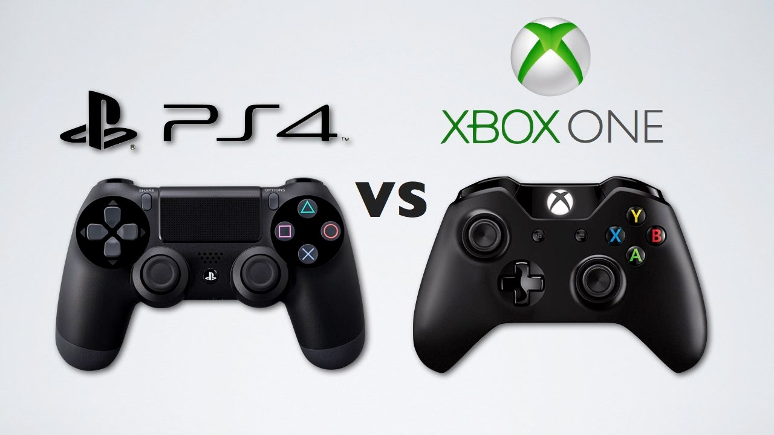
Digital Buttons
States are packed into a 32-bit word
Unidirectional axis
Produce floating-point input values in the range [0,1]
Bidirectional axis
Producing floating-point input values in the range [-1,1]
Relative axis
Produce floating-point input values in the range [-1,1] where the range represents the maximum relative offset
Notes:
Input remapping allows the player to select their own particular control scheme.
Some games allow players to configure the entire control scheme to their own personal liking (particularly PC games where the keyboard is the primary input device) while others allow players to select from a small set of preconfigured setups (Halo offers up a range of control schemes that try to account for a range of personal tastes for instance).
To implement this, we can assign each function in the game (jump, fire, move forward, duck etc) a unique id and then produce a simple table which maps each physical control index to a logical game function. Whenever the game wants to determine whether a given game function should be activated, it does a lookup against the table and reads the state of the assigned control. To change the mapping, we can either swap out the table wholesale (Halo style) or allow specific entries to be changed by the player (Battlefield)
There are some other considerations – different controls generate different outputs, axis for analogue controls might range from -32,768 to 32,768 or from 0 to 255 or any other range. Meanwhile, the state of digital buttons is just a 0 or a 1 packed into a suitable integer type – so we need to ensure we only permit mapping of controls that make sense (we shouldn’t allow a digital button to try and represent an analogue axis!)
We can get around this in some respects by normalizing our input values to a constrained range – so all our analogue axis will fit within -1 to 1 or 0 to 1 or similar, though we need to think about the differences between triggers (0 to 1) and joysticks (bidirectional: -1 to 1) and how we handle those. It might be easier to classify our inputs into a small set of classes that have specific constraints:

Slide 20
FIN

Slide 21
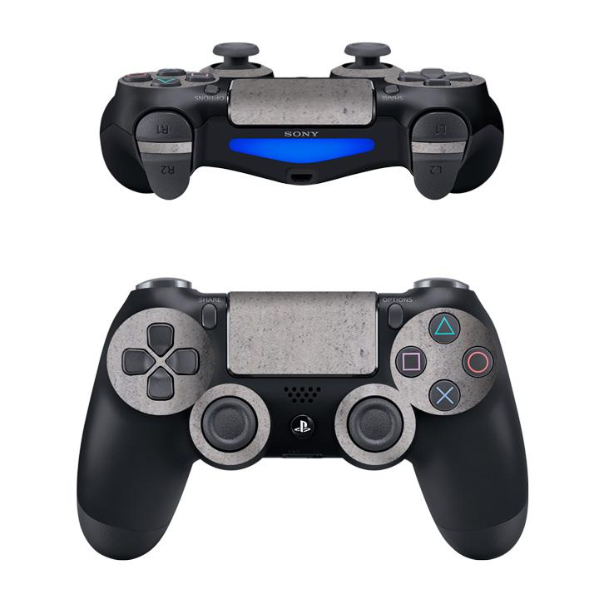
1000110011001100
&
X 1000000000000000
=
1000000000000000
If(Pad.buttons & XBUTTONMASK)
{
//x button pressed!
}
Notes:
Many controllers will return there button states in 1 variable. Lets look at the PS4 controller.
We have a number of buttons and 4 analogue inputs (the triggers are analogue).
Lets focus on the buttons for now.
Ignoring the PS buttons, options and share (and the touch pad because stuff that thing!) we have 12 buttons (don’t forget that the analogue sticks can be clicked).
These buttons will only tell us if they are pressed or not. A 1 or a 0.
If only we could represent this information in a string of 1’s and 0’s. WHY oh WHY dose such a thing not exist!?
… oh wait… binary, that’s what we need!
We can us one bit to represent each button.
We could simply use individual bool’s for each button but we wont, cos that looks messy.
Instead we will use one number, a uint16.
A uint16 has 16 bits, one bit for each button (we actually have 16 buttons on this controller but as I mentioned, we don’t care about them).
So we could use the following.. (see the binary number on the slide).
Each bit is button but how do we know which buttons are pressed?
Well we define which bit is which button (more specifically, SONY define this as a #define).
The X button might look like this.. (see the second binary number on the slide).
By anding these numbers together, we can isolage the X bit and then check its state.
So we could write code like this to see is the button has been pressed (see the code on the slide)

Slide 22
What’s the best way to implement input?

Slide 23
Like this?
OR
Like this?
If(xbutton)
{}
If(ybutton)
{}
If(turboButton) // there’s an old reference
{}
Switch(pad.buttons)
{
case: xbutton
case: ybutton
}
What if we need buttons to do more than one thing, like jump in game but confirm in menus?

